Slide 1

Exclusion Zone research
Parth Patel, Tanner Street, James Webber
Table of Contents

Slide 2
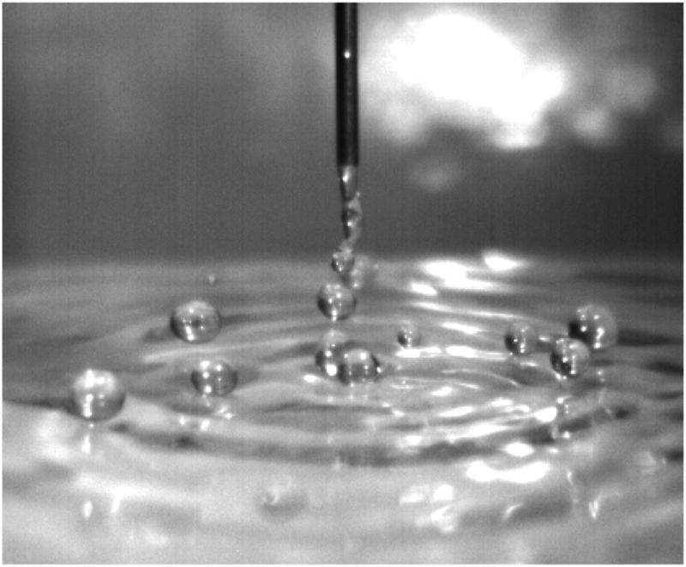
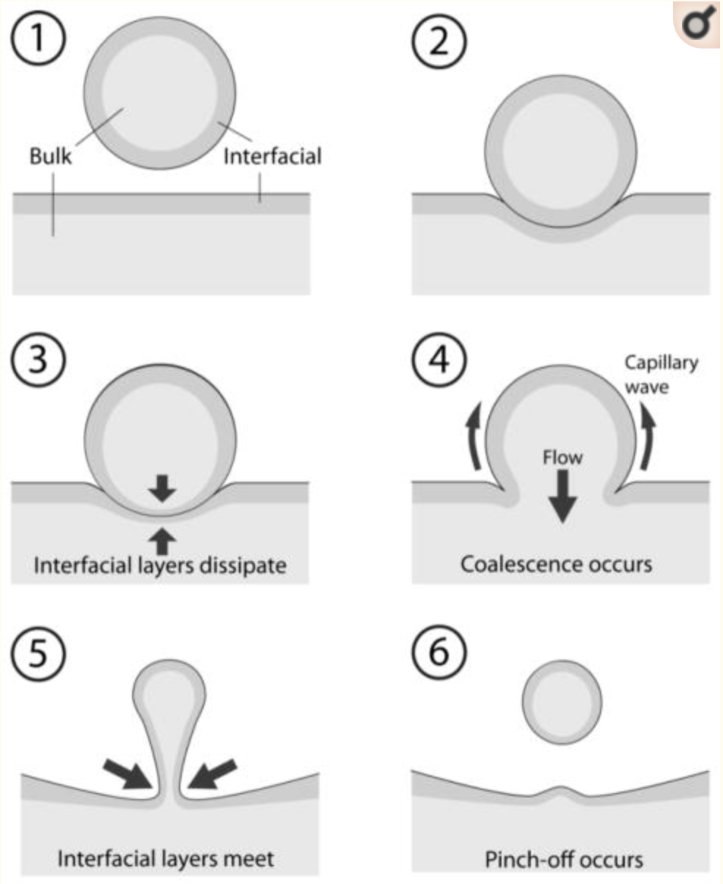
Persisting Water Droplets on Water Surfaces
Ivan S. Klyuzhin, Federico Ienna, Brandon Roeder, Adam Wexler, and Gerald H. Pollack
Previous belief: Thin air cushion underneath droplet
Results:
Larger droplets have longer residence times
Droplets with sideways velocities have longer residence times
Residual electric charge reduces residence time
Higher vertical velocities lead to immediate coalescence
Lower air pressure lead to shorter residence times
Coalescence is abrupt
Conclusion: Under controlled conditions, droplets do not coalesce immediately
Possible mechanism: EZ layers surround surface and do no allow coalescence. As droplet touched water the EZ layer dissipates near the surface and the droplet can coalesce
Notes:
James Webber

Slide 3
Unexpected Presence of Solute-Free Zones at Metal-Water Interfaces
B. Chai, A.G. Mahtani, and Gerald H. Pollack
Purpose: Measure a variety of EZ characteristics when the hydrophilic surface is a metal
Size: Largest EZ Zone found next to Zinc- 220 um (Zn>Al>Pb>W>Au/Pt)
Zn: Maximum 350 um at 20 mins and stabilized 220 um at 40 mins
Al: Grew slowly from 10 um to 100 um by 20 mins
Pb: Maximum 200 um at 15 mins and stabilized 100 um at 40 mins
W: EZ not visible until 20 mins then stabilized 70 um at 60 mins
Gold and platinum did not result in EZ layers
Observation: The nobler the metal, the smaller EZ formed
Electric Potential: Zn and Al only measured
Zn: Potential at surface approximately -200 mV
Al: Potential at surface approximately -120 mV, but inconsistent due to low fractional coverage
pH measurements: Zn had more significant pH changes than Al
Zn: pH of water went increased to ~10 before declining back to ~9, water more green
Al: pH of water from 5 to 7 within 60 mins, water less green
Notes:
Tanner Street- 03/09

Slide 4
...Continued
We know that there are EZs next to hydrophilic surfaces, but this paper found those zones next to various metals. The EZs had H+ ions.
There was correlation between EZ size and metal’s position within the galvanic series.
There was a reasonable correlation between the EZ pattern and the oxidation pattern of the metal. Oxidation occurred in places where there were gaps between EZ zones

Slide 5
Effect of buffers on aqueous solute-exclusion zones around ion-exchange resins
Zheng, J. M., Wexler, A., & Pollack, G. H. (2009). Effect of buffers on aqueous solute-exclusion zones around ion-exchange resins. Journal of colloid and interface science, 332(2), 511–514. https://doi.org/10.1016/j.jcis.2009.01.010
Goals
Exploration of cause behind exclusion of microspheres / colloids from proximity of ion-exchage beads
Takeaways
EZ is not a result of electrostatic repulsive effect
As previously demonstrated in studies, Size of EZ depends on pH however…..
EZ’s in salt water, pure water and buffer solutions are similar.
Ability of medium to conduct charge is also an important factor in EZ formation/stability
EZ stabalizes in buffer solutions
Conclusion:
There is a creation of an exclusion zone surrounding ion-exchange beads. This zone is possibly due to water restructuring itself to exclude particles not due to electrostatic forces

Slide 6
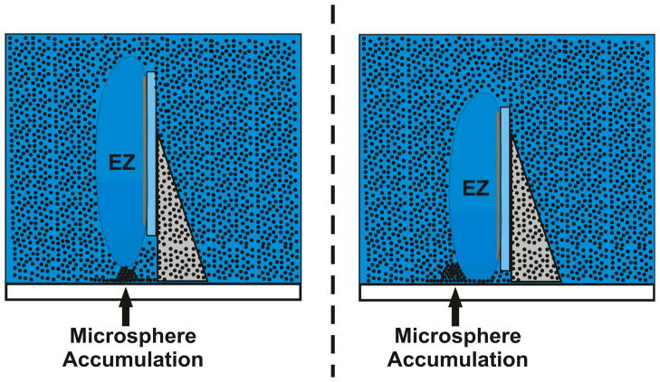
Exclusion-zone formation from discontinous nafion surfaces
Discontinuous regularly spaced nafion strips were placed on a glass surface. They notice that below a certain distance, the EZs would merge together. However, if the the strips were too far apart, then the EZs would remain separate. Mainly shows that EZs have the ability to merge together.
In addition, to the EZ zone, there exists a microsphere accumulation at a certain point on the EZ edge

Slide 7
Surfaces and Interfacial Water: Evidence that hydrophilic surfaces have long-range impact
Zheng, Chin, Khijniak, Khijniak Jr., and Pollack
2006 Sep 06
Purpose: Use various light absorption spectrum methods to identify EZ’s distinct structure relative to bulk water
Infrared Emission
Explanation of method: Use infrared camera on sample, infrared emission is function of temperature and stability, but temperature can be ignored due to lack of gradients in small spaces
Regions next to nafion was dark, indicating a more stable structure due to lack of emissivity
Regions further from nafion was light, indicating less stable structure
Distances of dark to bright region approximately the same as EZ size (~300-500 um)
Magnetic Resonance Imaging
Explanation of method: Apply magnetic field and radio frequency pulse and then measure time taken for relaxation, which is the the return to more stable spin state perpendicular to magnetic field
Took less time for interfacial water to relax thus indicating a less mobile, more stable phase (27.2 +- 0.4 ms of bulk water vs 25.4 +- 1 ms of interfacial water)
Uv-Vis Spectrophotometry
Explanation of method: Use Uv-Vis light to find differences in absorption amongst EZ and bulk water
EZ water had a peak at ~270 nm, differing from the bulk water
Notes:
Tanner Street- 03/10

Slide 8
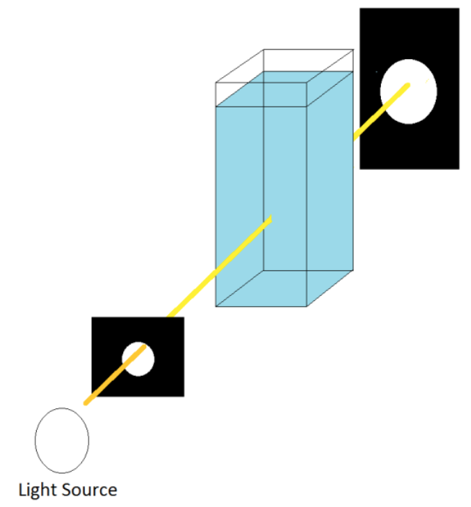
Exclusion zone as intermediate between ice and water
E. So, R. Stahlberg & G. H. Pollack
Theory: Ice transitions to exclusion zone type water before it transitions to bulk water
Results:
As the ice melts the light absorption peaks at 271 +/-7 nm wavelength
Peak lasts for several to 30 seconds
Peak usually occurs after a minute of ice being introduced to the water
Conclusion: the 270 nm peak in the absorption spectrum appears during the course of melting
Future work: working to see if the same EZ can be found in freezing water. Currently large EZ zones have been found as water is lowered in temperature towards freezing. Working on consistency.
Fig. Spectrometer setup. Light passed through the cuvette and to the spectrophotometer, which measured the amount of light absorbed.
Puzzling: Ice is crystalline, bulk water is not. Entropy increase is usually associated with energy loss. Ice to water behaves opposite.
Possible theory: EZ is a higher energy state than ice, because it has liquid crystalline order and separation of charge.
Notes:
James Webber

Slide 9
Freezing Transition of Interfacial Water at Room Temperature under Electric Fields
Eun-Mi Choi, Young-Hwan Yoon, Sangyoub Lee, and Heon Kang
Results:
By varying gap distance water was found to freeze at room temperature with an electric field of 10^6 V-m
Confined geometry is needed
This relatively weak electric field (10^6 V-m) can be found in proteins, clay, electrodes, and within the crevices of amino acids crystals and mineral rocks
Simulations predict water will freeze at 300 K if gap distance is set less than 7A
Notes:
James Webber

Slide 10
Visualization of Charge-Carrier Propagation in Water
Andrey Klimox and Gerald H. Pollack
2007 Aug 07
Goal/Question: Could charged aqueous zones(EZ water) appear when the nucleating surfaces were replaced by electrodes?
Background: EZ water appears around specific surfaces, such as nafion.
Conclusion: Charged zones did appear, this was shown via pH gradients. There was a low pH around the positive and high pH around negative
Both the microspheres, and also the pH-sensitive dye, were progressively excluded from the high-pH zone. Hence the high-pH zone, which is negatively charged, may be similar in character to the negatively charged solute-exclusion zone
Materials: Microspheres, microscope, ph dye, platinum wire welding electrodes, salt,
Notes:
Tanner Street

Slide 11
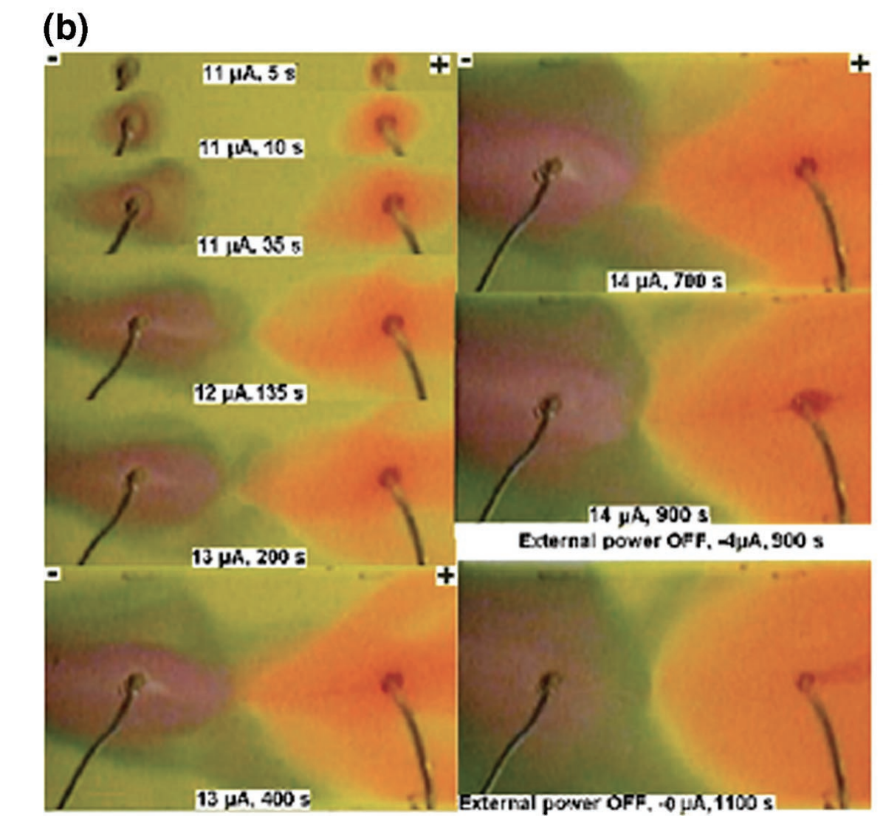
Cont….
Time course of pH change near vertically oriented electrodes at 4300 mV. Last panel shows color change following turnoff of input power at 900 s.

Slide 12
Water Freezes Differently on Positively and Negatively Charged Surfaces of Pyroelectric Materials
David Ehre, Etay Lavert, Meir Lahav, Igor Lubomirsky
Background info:
Electric field has the ability to induce the formation of icelike nuclei
Electrofreezing of ice has been reported near charged metallic electrodes
Pyroelectric materials are a way to isolate the net effect of the electric feild since there are other “effects” in place in the case of metallic surfaces (charged or uncharged).
Pyro electric surfaces are insulators but charges on their surface can be manipulated
LiTaO3 was used as the pyroelectric material
How it relates to us:
water molecules near surfaces in general, and near charged surfaces in particular, form clusters that are structurally different from those present in bulk water.
Conclusion:
Water freezes more easily at a positively charged surface.
Negative charged piezoelectric reduce freezing temp. Positive charged promote ice formation
Freezing on positive charged surface starts at solid/water interface. Freezing on negative charged surface starts at air/water interface.

Slide 13
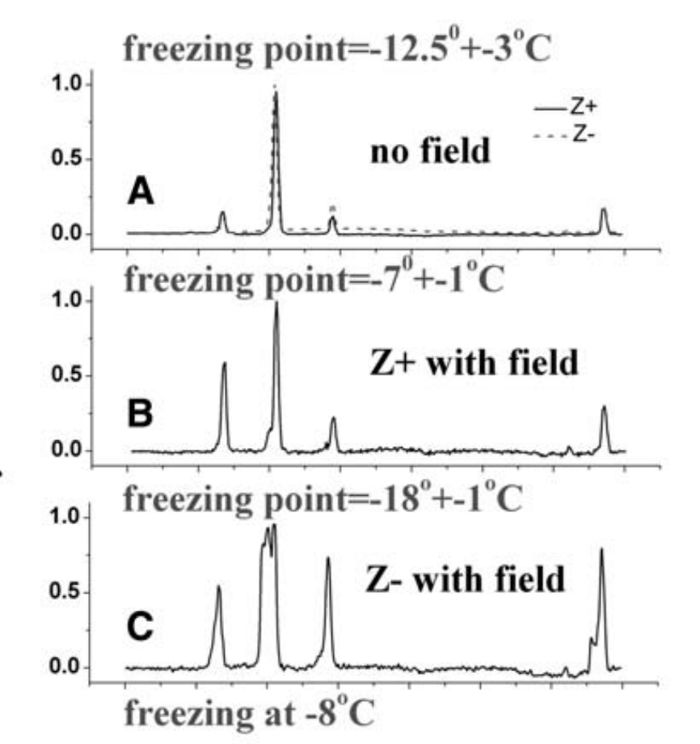
Cont...
Add description

Slide 14
High electric susceptibility is the signature of structured water in water-containing objects
Goal: To examine changes to the optical properties of water in exclusion zones. Is an high RI value an attribute of structured water?
Background: EZ water has a different refractive index rather normal bulk water
Some gels and biological objects with large (up to 95-99%) proportion of water have a refractive index (RI) (n = 1,42-1,50), significantly higher than RI (n0 = 1,333) of ordinary water.
The polarizability is linearly related to the electric susceptibility: The refractive index is thus a measure of the polarizability of the material
Conclusion: Refractive index of water in the vicinity of nafion is high. They performed analysis to confirm that the refractive difference was due to structured water (EZ water). A raised refractive index is a feature of structure water.
Other: Found that it is very likely that EZ water plays a role on the cellular level in mitochondria, bacteria, chloroplast, and etc…They observed change in refraction index of a mitochondria under inhibitors, and ATP stimulators
Notes:
The polarizability is linearly related to the electric susceptibility: The refractive index is thus a measure of the polarizability of the material

Slide 15
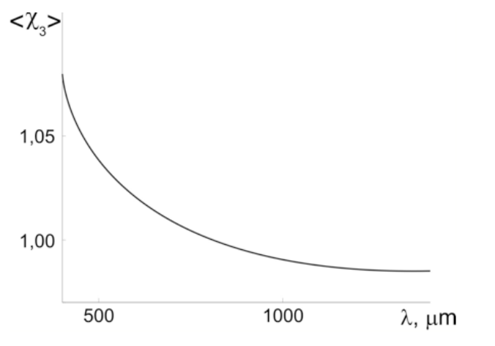
Cont….
Graph showing the calculated dependence of the susceptibility of the gel’s structured water component on wavelength

Slide 16
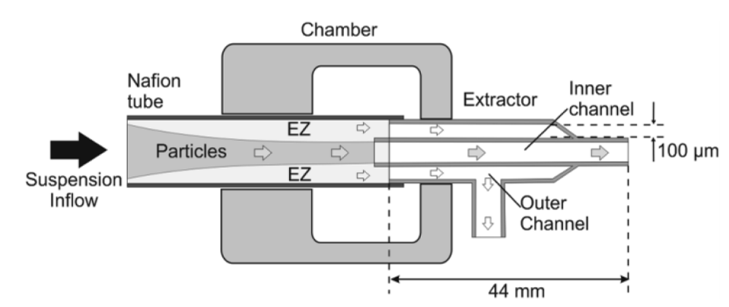
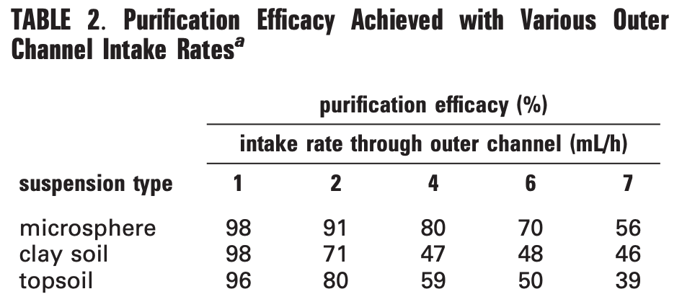
New method of water purification based on the particle-exclusion phenomenon
IVAN KLYUZHIN, ANDREW SYMONDS, JEFFREY MAGULA, GERALD H. POLLACK
Goal: to use the exclusion zone of water to obtain bulk water free of particles. Test proof-of-principle
Results:
Top soil, clay, silt added to water
Increased flow rate lead to smaller EZ thickness
15 ml/h input
70-90% of particles removed
Conclusion: Exclusion zone found in water
is able to separate particles and provide clean
water without the use of a physical filter
Concentricity limited result
Lack of physical filter means no clogging or
cleaning needed

Slide 17
Impact of Hydrophilic Surfaces on Interfacial Water Dynamics Probed with NMR Spectroscopy
Hyok Yoo, Rajan Paranji, Gerald H Pollack
Purpose: Use NMR spectroscopy to show that a distinct water structure exists around hydrophilic surfaces and is much more ordered than bulk water. This will be supported through T1 relaxation times; specifically, more ordered molecules return to relaxed spin states quicker since the applied magnetic field has a smaller effect on them.
Nafion and cationic gel beads used as surfaces to create EZ zones inside small NMR tube
In these particular solutions, there was no bulk water present at all, so all comparisons to bulk water are made using previously determined data
Cationic System:
Two chemical shifts recorded: 4.63 ppm and 6.00 ppm for internal (around the surface) and interstitial (within the surface) water respectively
The 4.63 ppm EZ water had T1 relaxation time significantly shorter than that of bulk water- 1.82 s vs 3.37s at 298 K
Nafion System:
Two chemical shifts recorded: 4.61 ppm and 5.35 ppm for internal (around the surface) and interstitial (within the surface) water respectively
The 4.61 ppm EZ water had T1 relaxation time significantly shorter than that of bulk water- 1.34 s vs 3.37s at 298 K
Notes:
Tanner 03/25

Slide 18
Solute-Free Interfacial Zones in Polar Liquids Binghua Chai and Gerald H. Pollack
Purpose: Test a variety of EZ characteristics in different polar liquids and observe the differences relative to water
Size
H20 (220 +- 17.8 um) > D20 (200+- 20.3 um) > Methanol (102+- 8.5 um) > Ethanol (38 +- 2.1 um) > Acetic Acid (30 +- 4.8 um) > Isopropanol (51 +- 3.5 um) > DMSO (47 +- 6.7 um)
Acetone dissolved microsphere and diethyl ether (non-polar) adhered to nafion surface
Ethanol Size Dynamics
See Figure in Next Slide
Electric Potential of Ethanol and Water
See Figure in Next Slide
Takes approximately 50 um to reach 0 potential for ethanol and 300 um for water, approximately corresponding to EZ sizes
Notes:
Tanner- 03/25

Slide 19
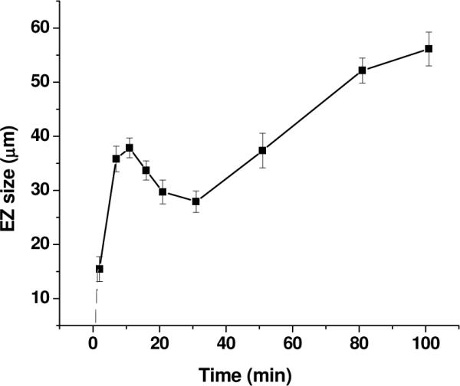
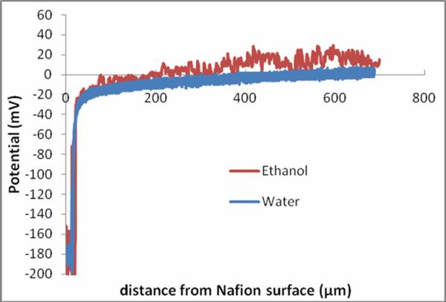
Continued…
Figure 1: Size dynamics of Ethanol EZ
Figure 2: Electric Potential of Ethanol and Water

Slide 20
Continued…
Effect of microsphere size and charge on EZ size
Wanted to eliminate idea that microsphere repulsion from the zone was occurring, particularly since they were using negatively charged carboxylate microspheres
See next slide for table of results concerning microsphere charge (Note: amino is positively charged and polystyrene is nearly neutral)
For microsphere size, the researchers used carboxylate microspheres with diameters 1, 2, and 4.5 um in ethanol
Regardless of size, EZ was always present in ethanol
The EZ grew to larger sizes when larger microspheres were used
Effects of IR radiation on polar liquids
Water absorption is highest at 3.1 um and is where the EZ is largest in water, so the researchers wanted to see how EZ in other polar liquids would react to IR radiation
Used ethanol for this experiment, exposed the liquid to wavelengths 1.7 um-3.6 um and compared growth to a control value for ethanol
3.4 um largest size growth, which, similar to water, is the maximum absorption for ethanol
See figure on next slide
Notes:
Tanner- 03/25 and 04/15

Slide 21
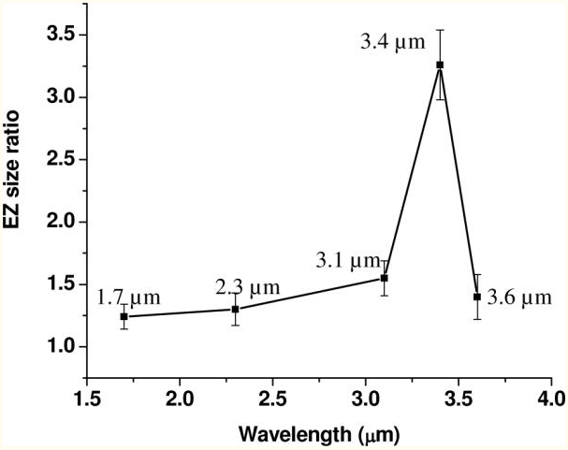
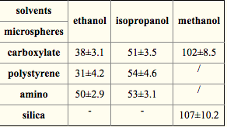
Continued…
Figure 3: The effect of IR radiation on the size of EZ in ethanol (Note: The y-axis is taking the new size and dividing by a control value for ethanol, so it represents how many times bigger the new size is)
Table 1: Effect of different microsphere charges on EZ size (carboxylate=negative, amino=positive, and polystyrene=neutral)

Slide 22
Compelling Alternate Theories For Exclusion Zone Phenomena in Water and Other Liquid Daniel C. Elton
Purpose: Provide critiques to the EZ water theory as well as alternate theories that could explain previously observed behaviors and measurements. I see this paper as a general starting point by which we could go into more depth on specific critiques. We could also use our research into other papers to verify or dispel these critiques.
Thermodynamic critiques:
Hexagonal sheet structure would result in explosion due to high energy cost (Hasted, need to revisit and see if I can find specific numbers/verbiage)
Quantum chemistry calculations show that structure is unstable (Seggara-Martí et al, need to verify more but struggle with content understanding)
H302⁻ ion cannot exist for longer than ~110 fs (femto=10^(-15))
X-Ray crystallography critiques:
X-ray crystallography on electrically-induced water bridge does not show change in internal structure; specifically, the water in the bridge does not show anisotropic properties/behavior
Author claims that x-ray crystallography has not been done on EZ water, so this would be a good experiment to test the theory
Uv-vis critiques:
Pollack’s lab has shown similar peaks to 270 nm in salt solutions, such NaCl and KCl, so this peak could be indicative of a salt solution around Nafion
Answer: Find paper in which that peak was observed where the hydrophilic surface was not nafion.
Notes:
Tanner- Throughout Semester

Slide 23
Continued...
Alternate theory: Diffusiophoresis
Diffusiophoresis is spontaneous motion of a fluid in response to concentration gradient of something else
pH gradient could arise from the fact that nafion is a superacid
Florea et al. have performed experiments on the EZ and have shown that the data are fit by a model of diffusiophoresis.
Pollack has responded to this alternate theory in a paper that I cover in a different slide
Answer: What about surfaces other than nafion?
Alternate theory: Van der Waals Repulsion
Theory that attempts to explain EZ at metal surfaces due to lack of pH gradient, but author acknowledges that it needs to be fleshed out more
VdW Repulsion: Two materials of different composition repel each other when submerged in liquid, so metal-microsphere-water system would theoretically fall into the criteria
Water is not typically used in VdW repulsion studies since it can be easily contaminated with charge-bearing solutes, so this theory is not very concrete

Slide 24
Comment on “A Theory of Macromolecular Chemotaxis” and “Phenomena Associated with Gel–Water Interfaces. Analyses and Alternatives to the Long-Range Ordered Water Hypothesis
G.H. Pollack
Purpose: Respond to Schurr’s theory of Diffusiophoresis by providing arguments in favor of Pollack’s EZ theory. Regardless of the context, this paper provides more insight into EZ structure and how it stands up to critiques.
Pollack stresses that many alternate theories such as Schurr’s never claim that the EZ does not exist but rather deviate from its origin
Pollack’s counterpoints that illustrate the inefficiency of Schurr’s theory
EZ unrelated to near-surface gradients because rapid flow of water/microspheres (50,000 um/s) would dispel any of those gradients
Schurr’s alternate theory does not address light’s effect on EZ size
Schurr’s theory would imply that a pH gradient (illustrated by pH dye) would exist within the EZ zone itself; however, the EZ zone excludes the pH dye is thus colorless
The EZ grows with time and persists for a while (up to 2 weeks), despite the sustainability of a gradient
Surfaces that do not create chemical gradients result in EZ layers
Monolayers, metals, and biological surfaces also result in EZ layers
Schurr focused his arguments on microspheres; however, these are not the only materials excluded
Schurr claims that, if this theory was true, then certain biological observations would have to be made; however, Pollack counters that these observations have been made
Nobelist Albert Szent-Gyorgyi (considered the father of modern biochemistry) and Gilbert Ling have both provided evidence for ordering of water in biological environments
Diffusion in cells and halos around isolated cells

Slide 25
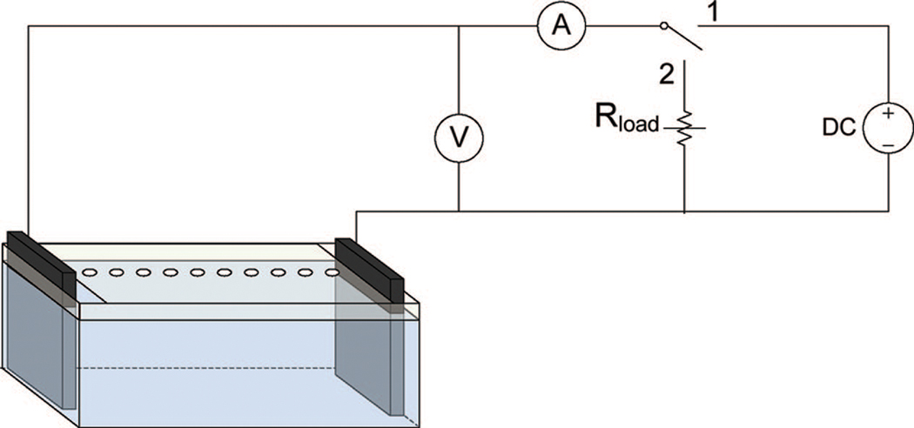
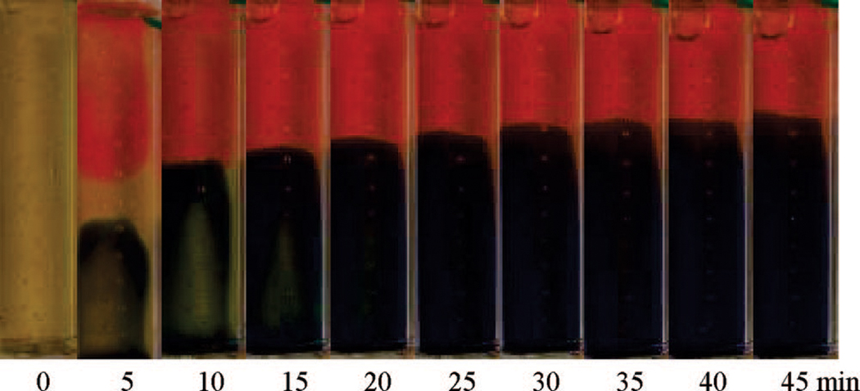
Can Water Store Charge?
Kate Ovchinnikova and Gerald H. Pollack
Goal: How well can pure water store charge, and ultimately recover it
Results:
When electrodes are placed in water pH dyes show distinct region of low pH and high pH, as opposed to a linear gradient
Charging dynamics: current has initial fall off, gradual growth, and then constant
Energy recovery procedure: 1s charge of 2.5V, 10mM NaCl solution
.14 mC recovered, .20 mC input, 70% recovered
Recovery percentage varies widely with parameters
3s charge time 25% recovery
Conclusion: biggest find was that separation of charge remained in the water for several hours after initial charge.
Up to 70% recovery

Slide 26
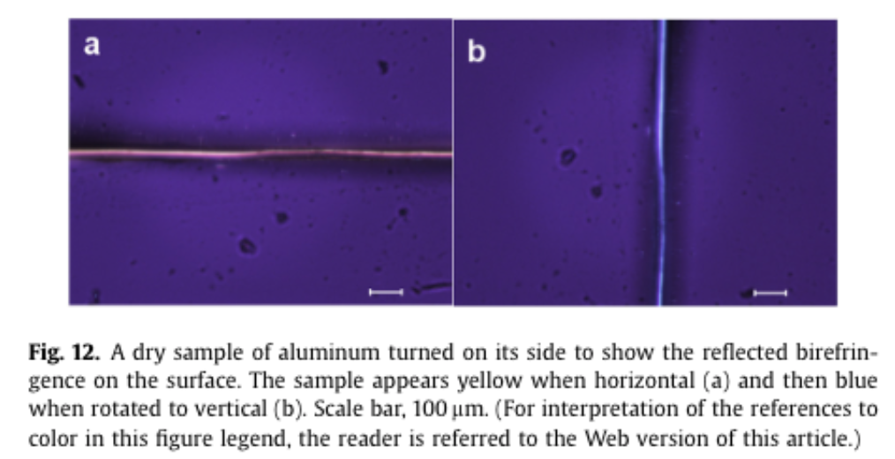
Exclusion zone water is associated with material that exhibits proton diffusion but not birefringent properties
Peter Spencer, James Riches, Elizabeth Williams
Goal: Opposition to the theory that EZ water has a crystalline structure
Results:
Polarized light microscopy used to detect long range order
Birefringence observed at nafion edge but not in EZ (present on knife edge not scissor edge)
Birefringence shown on dry aluminum
Birefringence shown on copper foil although no EZ was shown (similar to picture Pollack used to prove structured
EZ layer is not parallel to surface
Matches pattern of flowing ions
Conclusion: Presence of birefringence does not prove structured order of water in EZ. Alternate theory of proton flow

Slide 27
Structure of the floating water bridge and water in an electric field
Purpose: Refute the claim that the floating water bridge phenomenon is a result of EZ water by performing X-ray diffraction experiments on the water bridge. Specifically, these diffraction experiments illustrate a lack of anisotropic behavior/characteristics in the water bridge.
Context:
Water bridge phenomenon: Large potential difference (~ 15 kV) applied to two beakers of deionized water in close proximity result in a connection of water seemingly floating in air instead of falling to the ground
Pollack claims EZ water can explain this phenomenon, specifically how the gel-like structure prevents any drooping or falling
X-ray diffraction can identify anisotropic structure, which is typical of crystals and is defined as directional-dependence of certain characteristics
The experiment
Completed x-ray diffraction experiments on normal deionized water as well as the water bridge at different conditions and compared the results
See figure

Slide 28
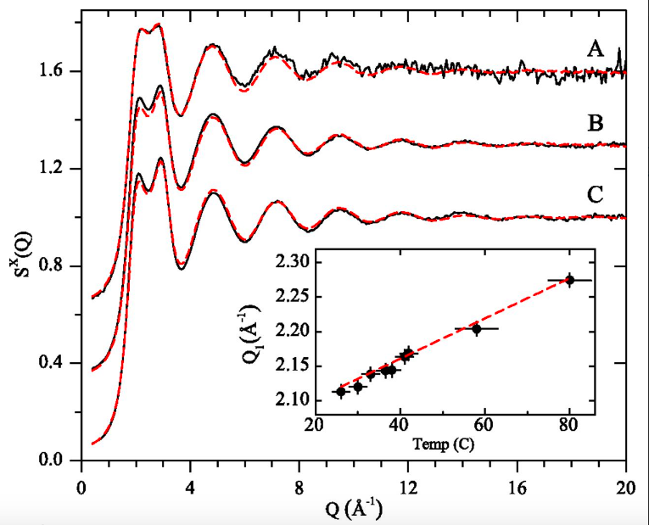
Continued
The y-axis is measuring diffraction pattern with respect to scattering vector (inverse angstroms)
The red dashed lines represent bulk deionized water While the black line represents the water bridge
A= 58 C, 17 kV, 9.4 mm bridge B= 42 C, 15 kV, 7 mm long C= 26 C, 15.5 kV, 7 mm long
More to come

Slide 29
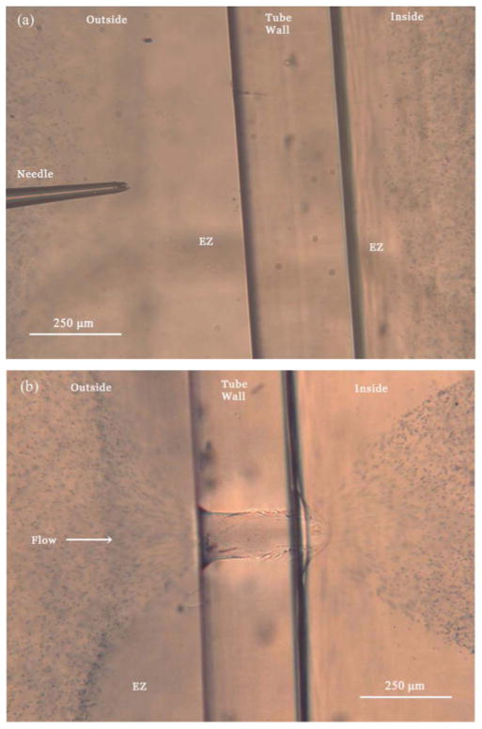
Unexpected water flow through Nafion-tube punctures
Colin O’Rourke, Ivan Klyuzhin, Ji Sun Park, and Gerald H. Pollack
Goal: to discover the source of energy that allows the water to flow into the nafion tube
Results:
0.2 mm puncture
Fluid flows inward
Menisci moves outward
Outer EZ layer did not change size
As inner EZ layer shrunk flow decreased
Repeated with Tygon tube (no EZ) and there was no flow
Acidic and basic solutions to study effect of EZ size on flow rate
Flow in all situations lasted approx. 1 hour
Conclusion: EZ water creates excess protons that increase the pressure of water nearby. Could potentially explain Xylem behavior

Slide 30
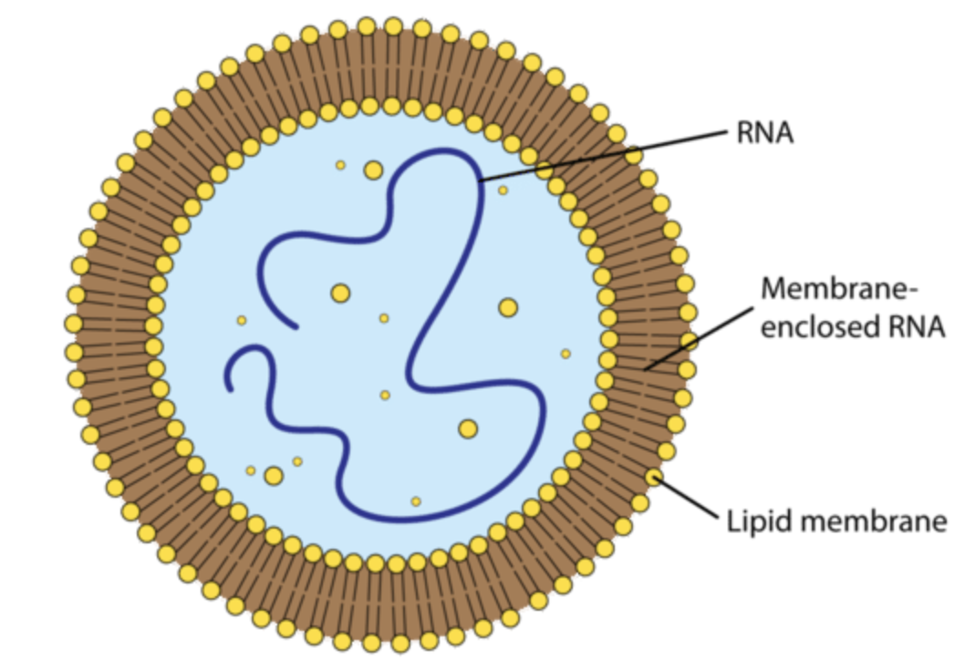
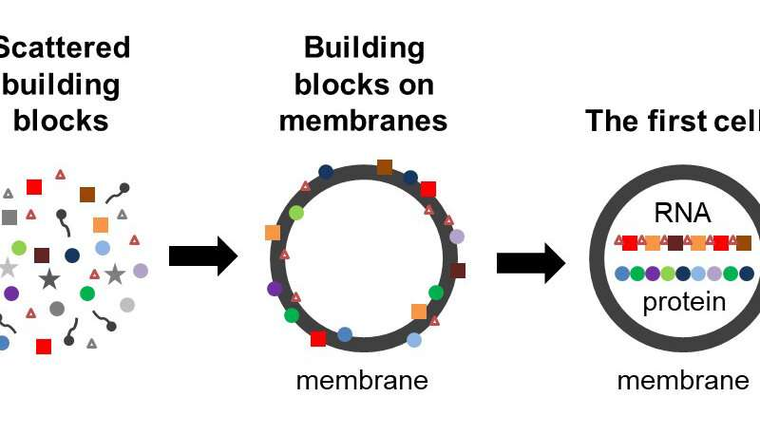
Origin of microbial life hypothesis: A gel cytoplasm lacking a bilayer membrane, with infrared radiation producing exclusion zone (EZ) water, hydrogen as an energy source and thermosynthesis for bioenergetics
Origin of the first cell is debated however regardless scientists are still confronting with understanding a plausible structure for the first cell(s) capable of regulated metabolism, growth and division
Cell membrane
Is not created from new during cell division
Essential to a cell as it encloses: cytoplasm, genetic material, provides internal environment and etc
Hypothesis: cell membrane was not needed for the first cells. There was perhaps something simpler

Slide 31
Cont ….
EZ water membrane
EM / Infrared Radiation could have possibly created an EZ layer surrounding the gel
The charge differential in the −100 to −200 mV range at the EZ boundary may have been a plausible location for beginning of the assembly of an eventual primitive cytoplasmic membrane. Present-day bacterial cytoplasmic membranes (e.g., E. coli) also have a charge differential in the −85 to −154 mV range depending on the pH;
Charge gradients in cytoplasm allowed molecules to move within the cytoplasm
Possible Implications
It is possible that a better understanding of radiation, gels, hydrogen, water, thermosynthesis, thermocycling, charges, genomes, pre-membrane boundaries, exclusion zones (EZ) and boundaries, will assist in generating artificial life using a systems biology approach.

Slide 32
Convection associated with exclusion zone formation in colloidal suspensions
Goal: Present a cause for EZ formation
Exclusion zone formation is also referred to as aureole formation, and formation of unstirred layers
Results:
New characteristic of EZ: substantial convective flows that accompany EZ formation
Proposal exclusion zone formation is caused by a combination of ion-exchange at the surface, diffusion of ions, and diffusiophoresis of particles in the resulting ionic gradients
Diffusiosmosis takes place when a solution exhibiting a solute concentration gradient is in contact with a charged surface. Flow is generated by two mechanisms: Chemic-osmosis = solute concentration gradient. Electro-osmosis = ion concentration gradient
Conclusion
Ion-exchange between nafion and surrounding solution leads to a solute concentration gradient. The presence of the ion concentration gradient next to nafion pushes the particles away

Slide 33
